Slide 1
IE469 Industrial Applications of Operations Research
Spring 2017

Slide 2
Agenda
Charts
Pivot tables
Analysis Toolpak

Slide 3
Features of Effective Reports
Informative and fact-based
Formally structured
Written with a specific purpose and reader in mind
Always include section headings
Often use bullet points
Often includes tables or graphs
Offer recommendations for action

Slide 4
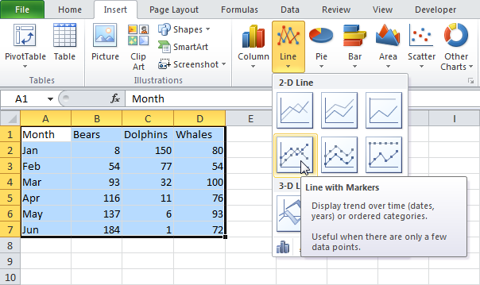
Charts

Slide 5
Using Charts to Create Effective Reports
Communicating your study’s results to your co-workers, managers, and clients in a way that is both professional and easy to understand is a crucial skill for any researcher.
Many studies with amazing results are not acted on or fall to the wayside because of its confusing report.
In a report, charts go a long way in illustrating findings that are clear and concise. They simplify data in a presentable and visually pleasing way.

Slide 6
Using Charts to Create Effective Reports
The main challenge with using charts is selecting the correct type from the wide variety available.
Many people do not understand the strengths and weaknesses that come with each chart type, either selects the nicest-looking or staying in their comfort zone by overloading their report with pie or vertical bar charts.
This class: review chart types

Slide 7
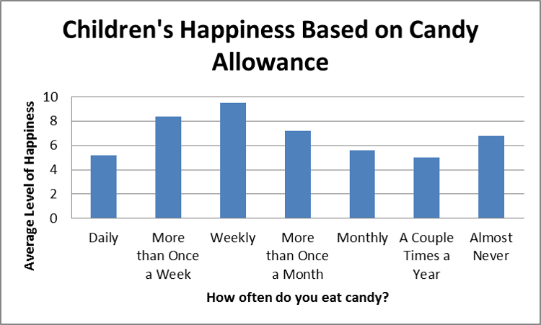
Bar Charts
Bar charts are best for comparing means or percentages (vertical: 2 to 7 groups, horizontal: more).
Each bar is separated by blank space. For this reason, the x-axis should be based on a scale that has mutually exclusive categories, but not on a continuous scale.

Slide 8
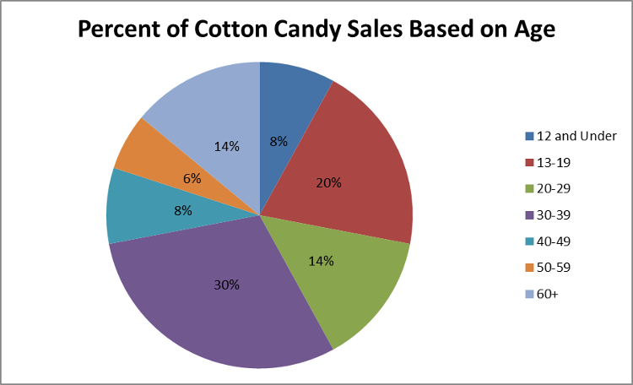
Pie Charts
Illustrate a sample break down in a single dimension.
When you want to show differences within groups based on one variable.
Pie charts should only be used with a group of categories that combine to make up a whole.

Slide 9
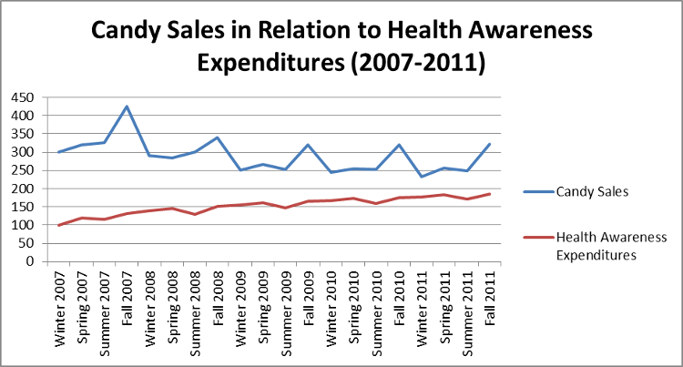
Line Charts
Illustrate trends over time (e.g. measure the long term progression of sales).
Also compare two or more different variables over time.

Slide 10
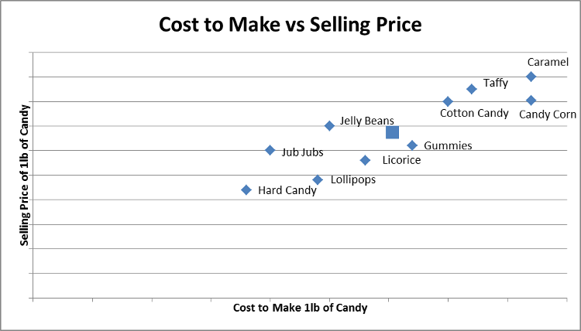
Scatter Plot
Scatter plots are used to depict how different objects settle around a mean based on 2 to 3 different dimensions.
This allows for quick and easy comparisons between competing variables.
(e.g. compare candies to one another based on its cost and selling price.
A viewer can quickly reference the difference between two objects or its relation to the average.

Slide 11
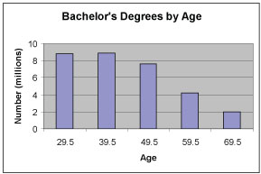
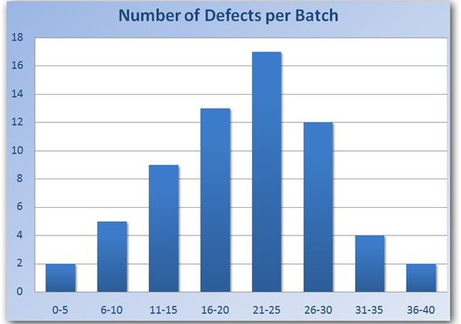
Histogram
Like pie charts, histograms break down the sample distribution in one dimension.
The difference is that they are ideal for illustrating sample distributions on dimensions measured with discrete intervals.
Unlike bar charts, the x-axis is not divided into mutually exclusive categories, it is a continuous scale.

Slide 12
Bad Charts

Slide 13
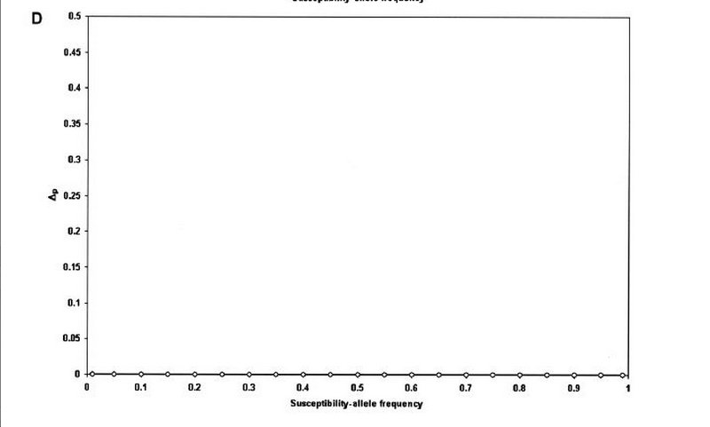
Bad Charts
This chart — which took up half of a page — indicated that all values were zero.

Slide 14
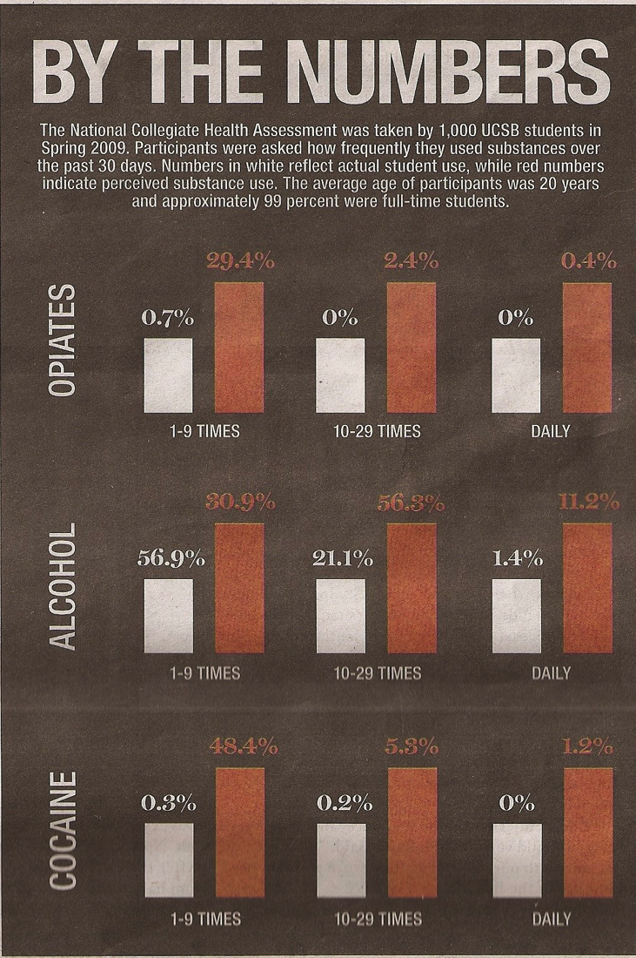
Bad Charts

Slide 15
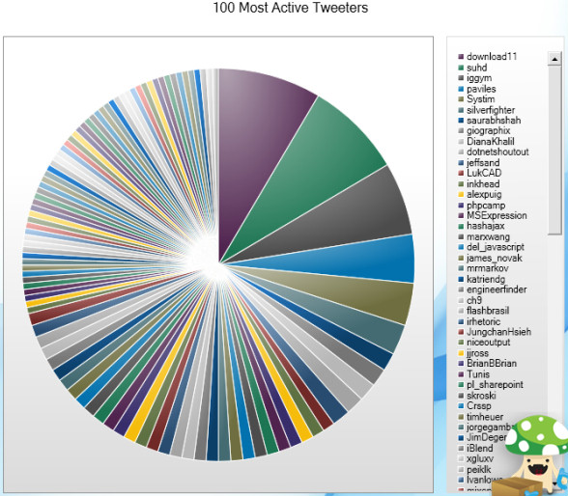
Bad Charts

Slide 16
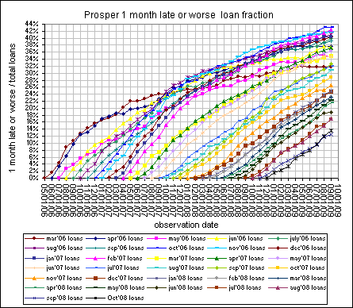
Bad Charts

Slide 17
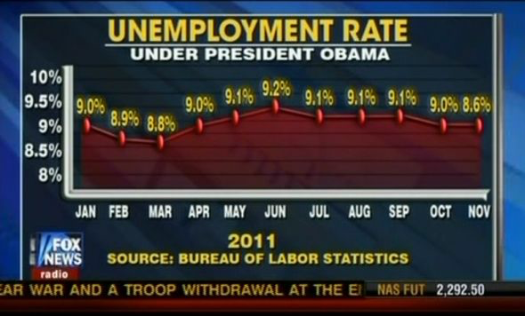
Bad Charts

Slide 18
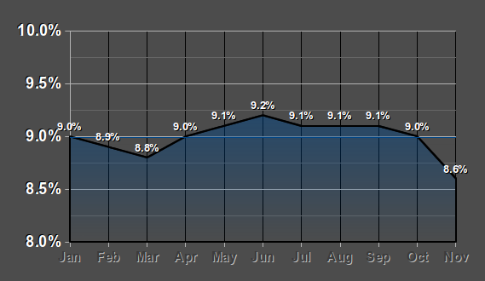
Bad Charts

Slide 19
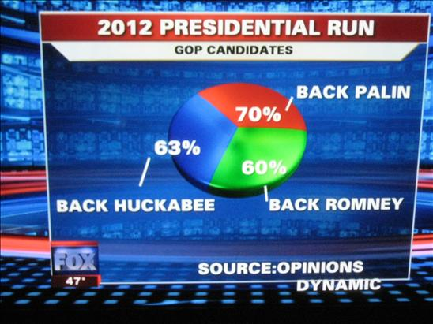
Bad Charts

Slide 20
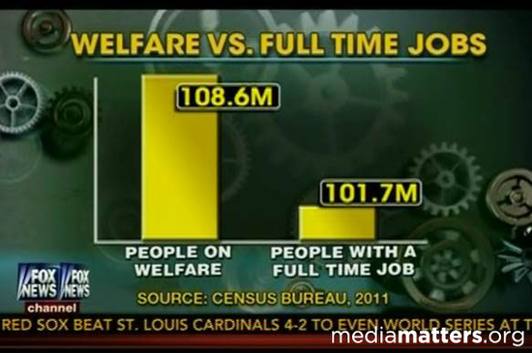
Bad Charts

Slide 21
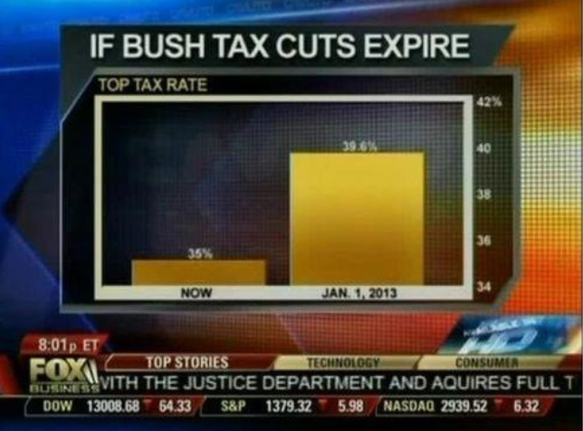
Bad Charts

Slide 22
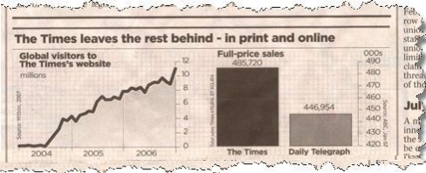
Bad Charts

Slide 23
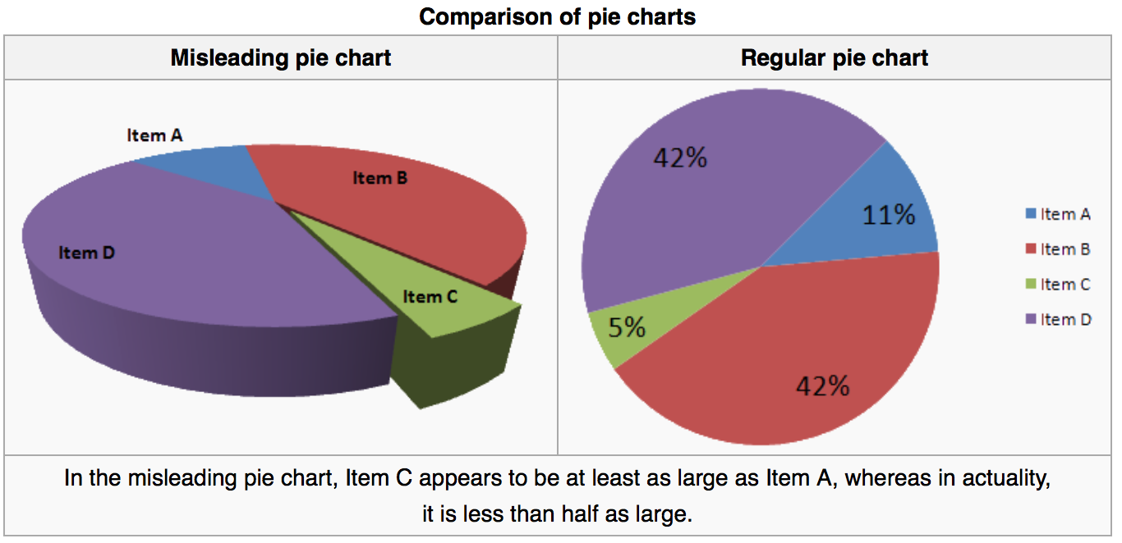
Bad Charts

Slide 24
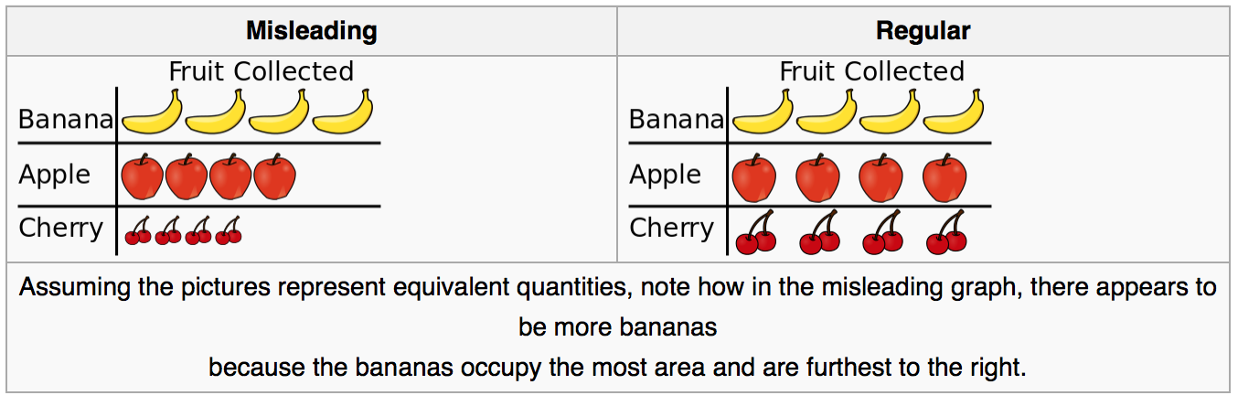
Bad Charts

Slide 25
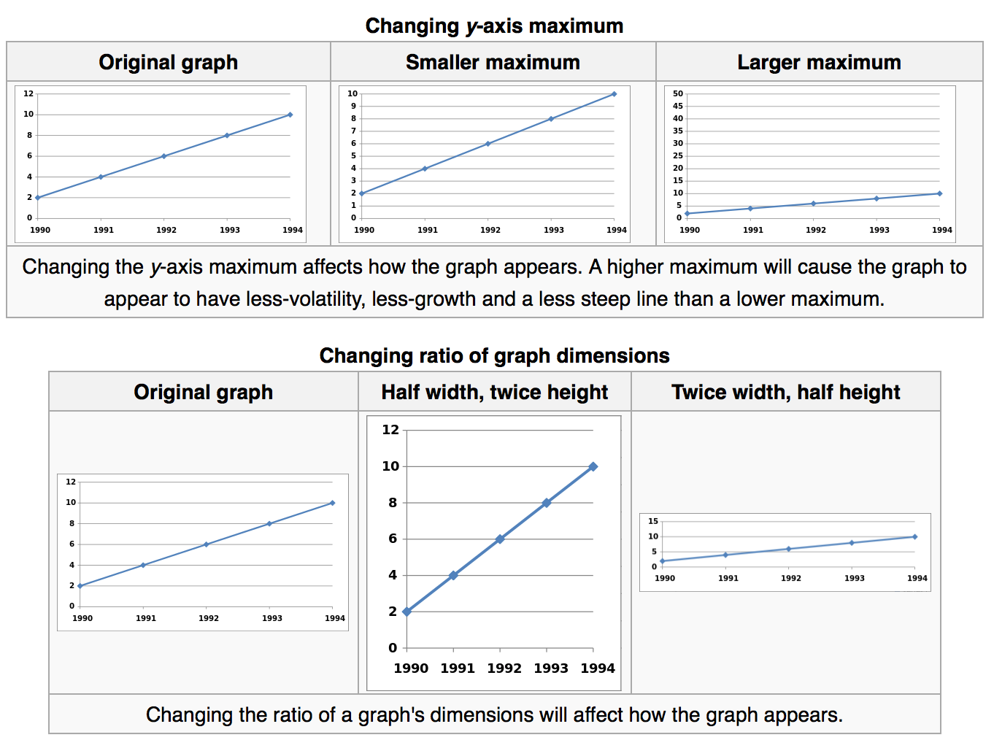
Bad Charts

Slide 26
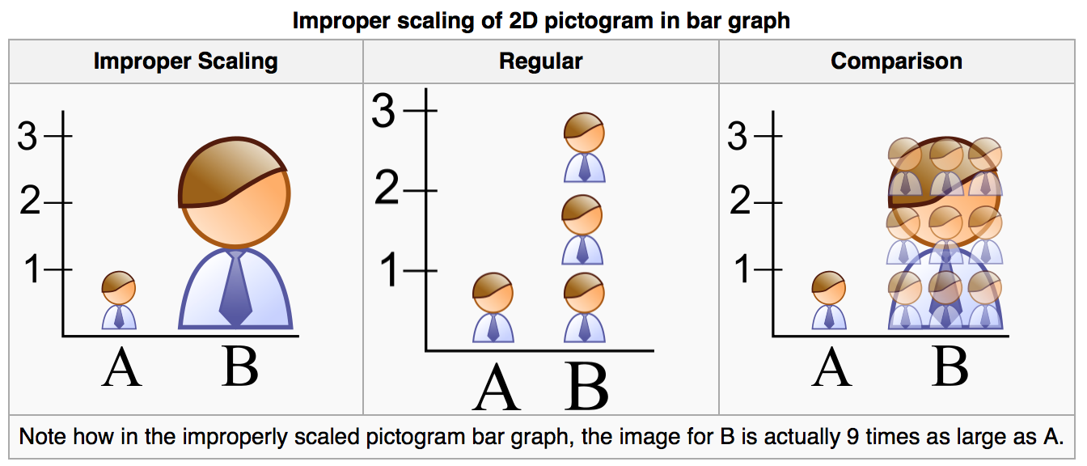
Bad Charts

Slide 27
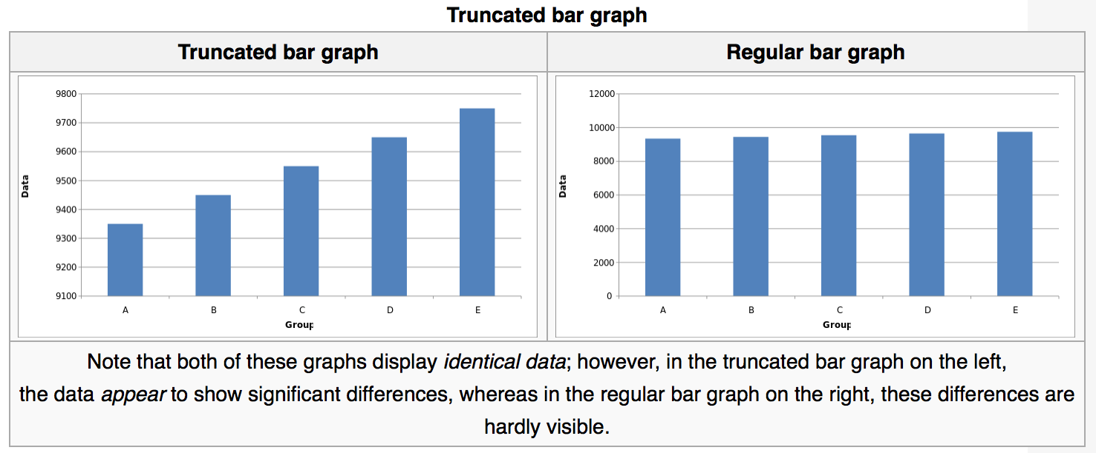
Bad Charts

Slide 28
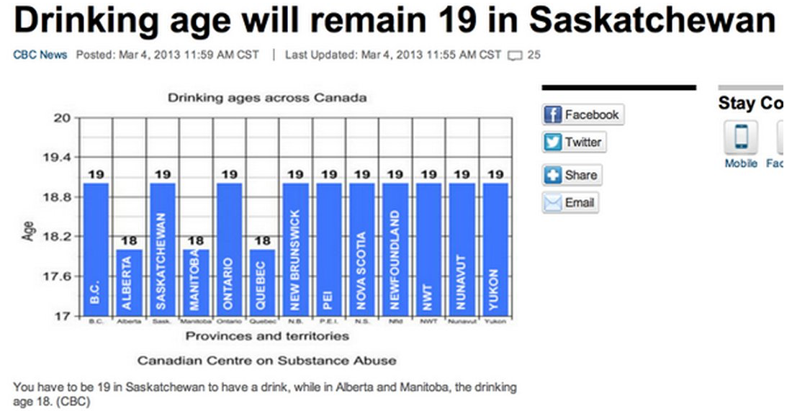
Bad Charts

Slide 29
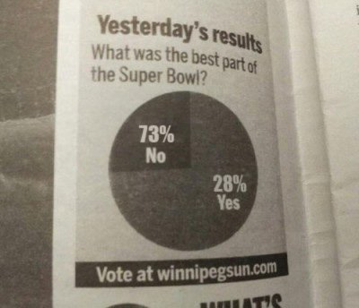
Bad Charts

Slide 30
Pivot Table and Chart
In data processing, a pivot table is a data summarization tool found in data visualization programs such as spreadsheets or business intelligence software.
A pivot table can automatically sort, count total or give the average of the data stored in one table or spreadsheet, displaying the results in a second table showing the summarized data.

Slide 31
Pivot Table and Chart
The user sets up and changes the summary's structure by dragging and dropping fields graphically. This "rotation" or pivoting of the summary table gives the concept its name.

Slide 32
Analysis ToolPak to perform data analysis
Anova
Correlation
Covariance
Descriptive Statistics
Exponential Smoothing
Histogram
Moving Average
Random Number Generation
Regression
t-test
z-test

