Slide 1
More VBA
IE 469 Fall 2017

Slide 2
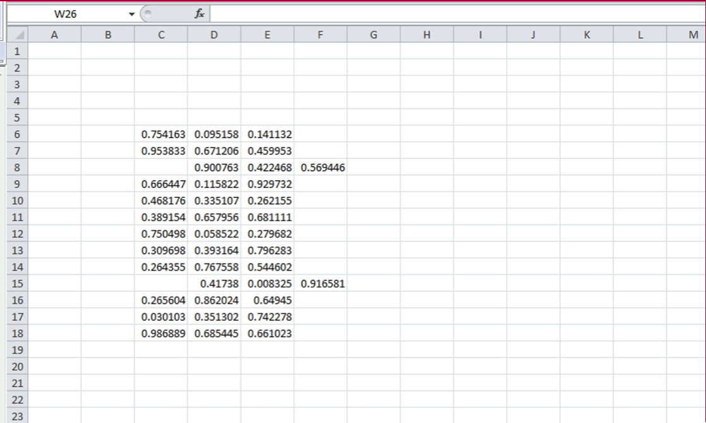
Recall The Problem

Slide 3
Problem
We have data spanning 3 columns and 13 rows (C6:F18).
  Data should be stored in the given range in order to use it for other application.
  Unfortunately, there are some errors in the data entry process, so some of the rows are shifted to the right by one column.
Our job is to correct all these mistakes:
  First, record a simple macro that correct a speciﬁc row (say Row 8).
  Then, tweak it to make correction in any given row.
  Finally, we let the code check any mistake and correct it.

Slide 4
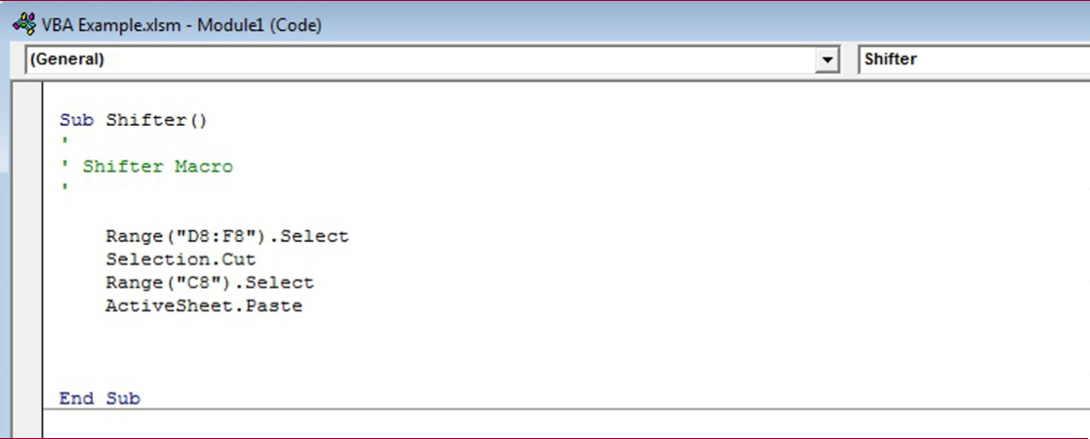
Last Time

Slide 5
Subroutines with Input Arguments
The limitation of Shifter is that it only corrects Row 8.
We can solve this by creating a subroutine which will take a row number as an input parameter.
Sub ShiftOneColumn (RowNum As Integer)
CODE BLOCK
End Sub
RowNum is the input variable.
As Integer part declares the data type of our input variable.

Slide 6
Shifting Any Given Column
How do we tell VBA to shift the row according to our input, RowNum?
  Currently, we select cells D8,E8,F8 by writing "D8:F8".
  We will construct that D#:F# syntax, for our row # (i.e., RowNum)
  Range("D" & RowNum & ":F" & RowNum).Select
  In Excel and VBA the & operator simply combines (“concatenates”) text together
Sub ShiftOneColumn (RowNum As Integer)
Range("D" & RowNum & ":F" & RowNum).Select
Selection.Cut
Range("C" & RowNum).Select
ActiveSheet.Paste
End Sub

Slide 7
Shifting Repeatedly
We now have a subroutine that can correct any given row.
  We want to apply this subroutine to any rows between 6 and 18.
  We use a loop (e.g., a FOR-NEXT Loop) for this task:
  Sub ShifterLoop()
  Dim RowNum As Integer
  For RowNum=6 To 18 Step 1
  Call ShiftOneColumn(RowNum)
  Next RowNum
  End Sub

Slide 8
Checking If First Column is Empty
We need to check whether the ﬁrst column of a row is empty or not.
VBA’s conditional statement IF-THEN-ELSE allows us to achieve this goal.
  Sub ShifterLoop()
  Dim RowNum As Integer
  For RowNum=6 To 18 Step 1
  If Cells(RowNum,3).Value="" Then
  Call ShiftOneColumn(RowNum)
  End If
  Next RowNum
  End Sub

Slide 9
Practice Problem
How would we extend our program if we wanted to have the program highlight each moved row with a yellow background?

Slide 10
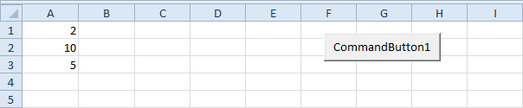
Loops (Cont’d)
Loop through Defined Range
Instead of index numbers, loops can be done via collections!
For example, we want to square the numbers in Range("A1:A3").

Slide 11

Loops (Cont’d)
First, we declare two Range objects. We call the Range objects rng and cell.
Dim rng As Range, cell As Range
We initialize the Range object rng with Range("A1:A3").
Set rng = Range("A1:A3")
Add the For Each Next loop.
    For Each cell In rng
    cell.Value = cell.Value * cell.Value
    Next cell

Slide 12
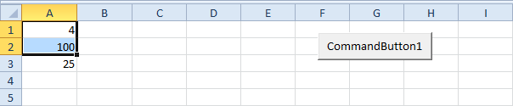
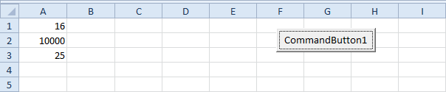
Loops (Cont’d)
If you want to check each cell in a randomly selected range, simply replace:
Set rng = Range("A1:A3")
with:
Set rng = Selection

Slide 13
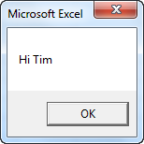
Strings
Join Strings
  We use the & operator to concatenate (join) strings.
    Dim text1 As String, text2 As String
    text1 = "Hi"
    text2 = "Tim"
    MsgBox text1 & " " & text2

Slide 14
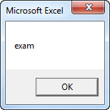
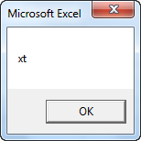
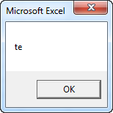
Strings (Cont’d)
Left, Right, Mid
  Dim text As String
  text = "example text"
  MsgBox Left(text, 4)
  MsgBox Right("example text", 2)
  MsgBox Mid("example text", 9, 2)

Slide 15
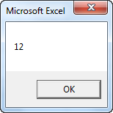
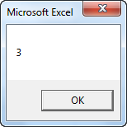
Strings (Cont’d)
To get the length of a string, use Len.
MsgBox Len("example text")
To find the position of a substring in a string, use Instr.
MsgBox Instr("example text", "a")

Slide 16
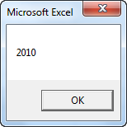
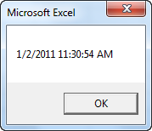
Date and Time
Year, Month, Day of a Date
  Dim exampleDate As Date
  exampleDate = DateValue("Jun 19, 2010")
  MsgBox Year(exampleDate)
  *Use Month and Day to get the month and day of a date.
Current Date and Time
  MsgBox Now

Slide 17
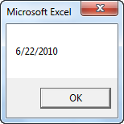
Date and Time
DateAdd
  To add a number of days to a date, use the DateAdd function. The DateAdd function has three arguments. Fill in "d" for the first argument to add days. Fill in 3 for the second argument to add 3 days. The third argument represents the date to which the number of days will be added.
  Dim firstDate As Date, secondDate As Date
  firstDate = DateValue("Jun 19, 2010")
  secondDate = DateAdd("d", 3, firstDate)
  MsgBox secondDate

Slide 18
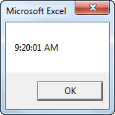
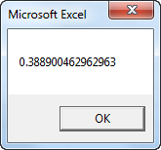
Date and Time (Cont’d)
The TimeValue function converts a string to a time serial number.
  MsgBox TimeValue("9:20:01 am")
  The time's serial number is a number between 0 and 1. For example, noon (halfway through the day) is represented as 0.5.
  Dim y As Double
  y = TimeValue("09:20:01")
  MsgBox y

Slide 19
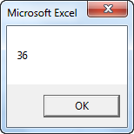
Date and Time (Cont’d)
The DateDiff function in Excel VBA can be used to get the number of days between two dates.
  Dim firstDate As Date, secondDate As Date, n As Integer
  firstDate = DateValue("Jun 19, 2010")
  secondDate = DateValue("Jul 25, 2010")
  n = DateDiff("d", firstDate, secondDate)
  MsgBox n

Slide 20
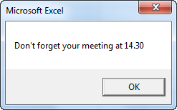
Date and Time
Example: Delay a Macro
  Sub reminder()
  MsgBox "Don't forget your meeting at 14.30"
  End Sub
Place a command button on your worksheet and add the following code line:
  Application.OnTime TimeValue("2:00:00 pm"), "reminder"
At 14:00:

Slide 21
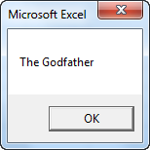
Arrays
An array is a group of variables. In Excel VBA, you can refer to a specific variable (element) of an array by using the array name and the index number.
One-dimensional Array
  Dim Films(1 To 5) As String
  Films(1) = "Lord of the Rings"
  Films(2) = "Speed"
  Films(3) = "Star Wars"
  Films(4) = "The Godfather"
  Films(5) = "Pulp Fiction"
  MsgBox Films(4)

Slide 22
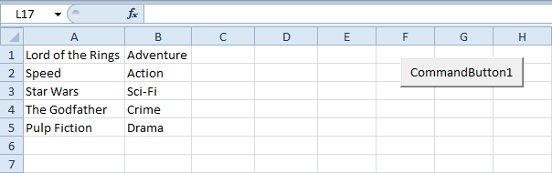
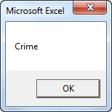
Arrays
Two-dimensional Array
  Dim Films(1 To 5, 1 To 2) As String
  Dim i As Integer, j As Integer
  For i = 1 To 5
  For j = 1 To 2
  Films(i, j) = Cells(i, j).Value
  Next j
  Next i
  MsgBox Films(4, 2)

Slide 23
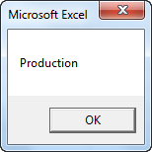
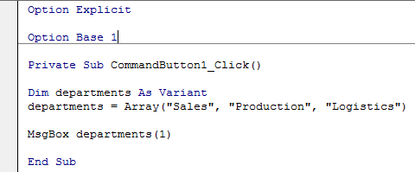
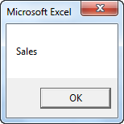
Arrays
The Array function in Excel VBA can be used to quickly and easily initialize an array.
  Dim departments As Variant
  departments = Array("Sales", "Production", "Logistics")
  MsgBox departments(1)
By default, the element's index of the array starts from 0.
  Add Option Base 1 to the General Declarations section if you want the index to start from 1.

Slide 24
Functions
The difference between a function and a sub in Excel VBA is that a function can return a value while a sub cannot. Functions and subs become very useful as program size increases.
If you want Excel VBA to perform a task that returns a result, you can use a function. Place a function into a module (In the Visual Basic Editor, click Insert, Module). For example, the function with name Area.

Slide 25

Functions
  Function Area(x As Double, y As Double) As Double
  Area = x * y
  End Function
You can now refer to this function (in other words call the function) from somewhere else in your code by simply using the name of the function and giving a value for each argument.
  Dim z As Double
  z = Area(3, 5) + 2
  MsgBox z

Slide 26
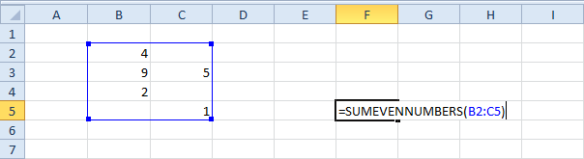
User Defined Functions
We want to create a function called SUMEVENNUMBERS that finds the sum of the even numbers of a randomly selected range.

Slide 27
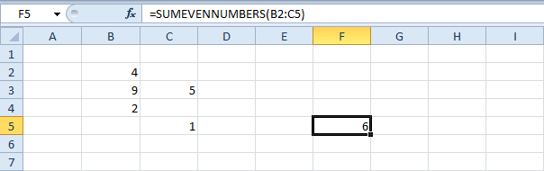
User Defined Functions
Open the Visual Basic Editor and click Insert, Module.
  Function SUMEVENNUMBERS(rng As Range)
  Dim cell As Range
  For Each cell In rng
  If cell.Value Mod 2 = 0 Then
  SUMEVENNUMBERS = SUMEVENNUMBERS + cell.Value
  End If
  Next cell
  End Function

Slide 28
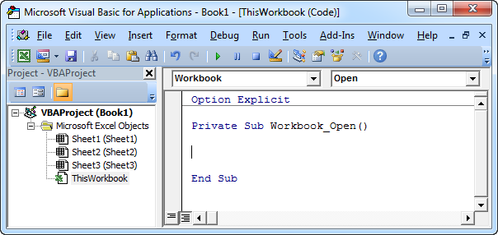
Events
Events are actions performed by users which trigger Excel VBA to execute code.
Workbook Open Event
  Code added to the Workbook Open Event will be executed by Excel VBA when you open the workbook.
  Double click on This Workbook in the Project Explorer.
  Choose Workbook from the left drop-down list. Choose Open from the right drop-down list.

Slide 29
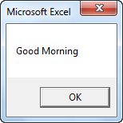
Events
  Add the following code line to the Workbook Open Event:
    MsgBox "Good Morning«
  Save, close and reopen the Excel file.
  Useful to display splash screens or MOTDs.

Slide 30
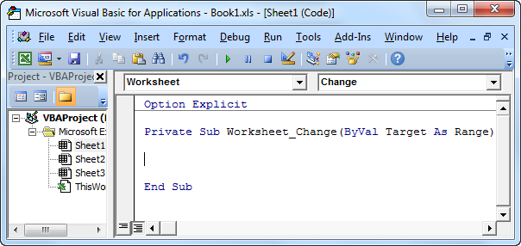
Events
Worksheet Change Event
  Code added to the Worksheet Change Event will be executed by Excel VBA when you change a cell on a worksheet.
  Double click on a sheet (for example Sheet1) in the Project Explorer.
  Choose Worksheet from the left drop-down list. Choose Change from the right drop-down list.

Slide 31
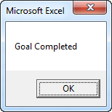
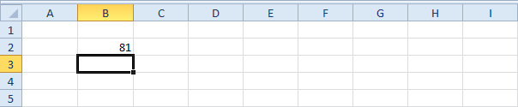
Events
  The Worksheet Change Event listens to all changes on Sheet1.
  We only want Excel VBA to do something if something changes in cell B2.
  To achieve this, add the following code lines:
    If Target.Address = "$B$2" Then
    If Target.Value > 80 Then MsgBox "Goal Completed"
    End If

Slide 32
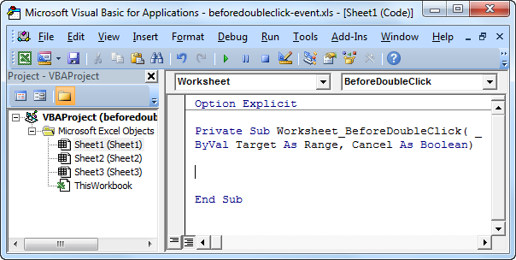
Events
Code added to the Worksheet BeforeDoubleClick Event will be executed by Excel VBA when you double click a cell on a worksheet.
  Double click on a sheet (for example Sheet1) in the Project Explorer.
  Choose Worksheet from the left drop-down list. Choose BeforeDoubleClick from the right drop-down list.

Slide 33
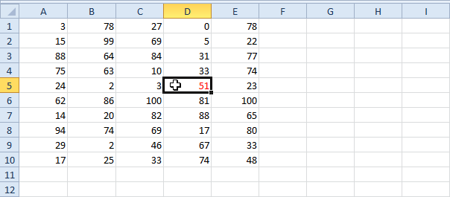
Events
The code line below colors the active cell red.
  Target.Font.Color = vbRed
Set the Cancel argument to true if you don't want the default double click action (cell edit mode) to occur.
  Cancel = True

Slide 34
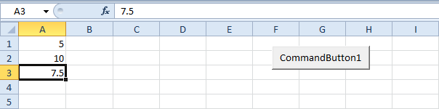
Application Object
The application object gives access to a lot of Excel related options.
WorksheetFunction
  You can use the WorksheetFunction property in Excel VBA to access Excel functions.
  Range("A3").Value = Application.WorksheetFunction.Average(Range("A1:A2"))

Slide 35
Application Object
If you look at the formula bar, you can see that the formula itself is not inserted into cell A3. To insert the formula itself into cell A3, use the following code line:
  Range("A3").Value = "=AVERAGE(A1:A2)"

Slide 36
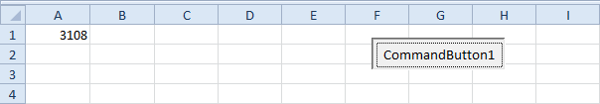
Application Object
ScreenUpdating
  Sometimes you may find it useful to disable screen updating (to avoid flickering) while executing code. As a result, your code will run faster.
  Dim i As Integer
  For i = 1 To 10000
  Range("A1").Value = i
  Next i
  Dim i As Integer
  Application.ScreenUpdating = False
  For i = 1 To 10000
  Range("A1").Value = i
  Next i
  Application.ScreenUpdating = True

Slide 37
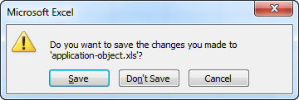
Application Object
DisplayAlerts
  You can instruct Excel VBA not to display alerts while executing code.
    ActiveWorkbook.Close
    Application.DisplayAlerts = False
    ActiveWorkbook.Close
    Application.DisplayAlerts = True
  As a result, Excel VBA closes your Excel file, without asking you to save the changes you made. Any changes are lost.

Slide 38
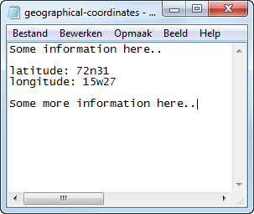
Read Text Files
We will look at a program in Excel VBA that reads data from a text file. This file contains some geographical coordinates we want to import into Excel.
We declare four variables. myFile of type String, text of type String, textline of type String, posLat of type Integer, and posLong of type Integer.
  Dim myFile As String, text As String, textline As String, posLat As Integer, posLong As Integer

Slide 39
Read Text Files
We need to initialize the variable myFile with the full path and the filename.
  myFile = "C:\test\geographical-coordinates.txt"
or
Use the GetOpenFilename method of the Application object to display the standard open Dialog box and select the file (without actually opening the file).
  myFile = Application.GetOpenFilename()

Slide 40
Read Text Files
Then, we open the file to read:
  Open myFile For Input As #1
  This statement allows the file to be read. We can refer to the file as #1 during the rest of our code.
  Do Until EOF(1)
  Line Input #1, textline
  text = text & textline
  Loop
  Note: until the end of the file (EOF), Excel VBA reads a single line from the file and assigns it to textline. We use the & operator to concatenate (join) all the single lines and store it in the variable text.
  Close #1

Slide 41
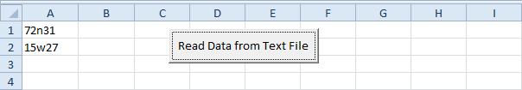
Read Text Files
Next, we search for the position of the words latitude and longitude in the variable text. We use the Instr function.
  posLat = InStr(text, "latitude")
  posLong = InStr(text, "longitude")
We use these positions and the Mid function to extract the coordinates from the variable text and write the coordinates to cell A1 and cell A2.
  Range("A1").Value = Mid(text, posLat + 10, 5)
  Range("A2").Value = Mid(text, posLong + 11, 5)

Slide 42
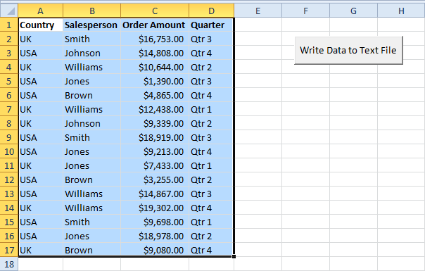
Write Text Files
We will look at a program in Excel VBA that writes an Excel range to a CSV (comma-separated-value) text file.

Slide 43
Write Text Files
First, we declare a variable called myFile of type String, an object called rng of type Range, a variable called cellValue of type Variant, a variable called i of type Integer, and a variable called j of type Integer. We use a Variant variable here because a Variant variable can hold any type of value.
  Dim myFile As String, rng As Range, cellValue As Variant, i As Integer, j As Integer
We specify the file to write and open the file
  myFile = Application.DefaultFilePath & "\sales.csv"
  Open myFile For Output As #1

Slide 44
Write Text Files
We set the range to write
  Set rng = Selection
Loop through the range and write each cell one by one
  For i = 1 To rng.Rows.Count
  For j = 1 To rng.Columns.Count
  cellValue = rng.Cells(i, j).Value
          If j = rng.Columns.Count Then
          Write #1, cellValue
          Else
          Write #1, cellValue,
          End If
  Next j
  Next i
  Close #1

Slide 45
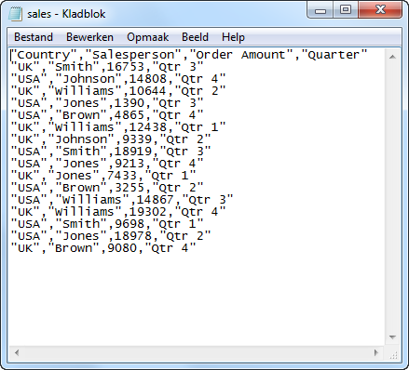
Write Text Files

Slide 46
NEXT TIME
ActiveX Controls and User Forms

