Slide 1
IE 469
Industrial Applications of Operations Research

Slide 2
Teaching Staff
Instructor | Dr. Emre Uzun E-mail: emreu@bilkent.edu.tr Offıce: EA 328 Tel: x3484 Office Hours: By appointment via email
Teaching Assistant | Çağlar Ulutaş

Slide 3
Industrial Applications of Operations Research
WHY?

Slide 4
Industrial Applications of Operations Research
The course is named as “Industrial” “Applications” of “Operations Research”
We will do some applications related to “industry” where you will utilize your OR background (and more...)
As you progress in this course, think of it as a real life job experience!
Pretend that you work at a consulting company and some tasks are assigned to you – I will definitely pretend that way!
Whether they are easy or challenging, you will have to do them.
Otherwise...

Slide 5
Industrial Applications of Operations Research
What can be an example application of OR in industry?
  Production Planning
  Inventory Management
  Transportation
  Queuing Systems
  How do you solve these problems?
  What tools to use?
Availability?

Slide 6
Industrial Applications of Operations Research
Many commercial software you use to handle these problems will NOT be available to you!
There will be no CPLEX, no GAMS, no XPress, no Arena.
  These software will cost $10,000+ each to get a license for a single computer.
In some instances there will be no Internet connection except for email.
  Especially in military or government based companies.
  You will not be able to download any “trial” version of these software.

Slide 7
Industrial Applications of Operations Research
The most commonly installed software is MS Office Applications.
  Word, Excel, PowerPoint, Access, Visio, Project…
Can you guess which one you would use the most?

Slide 8
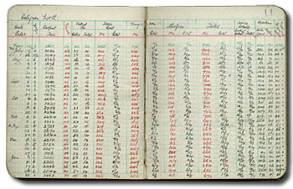
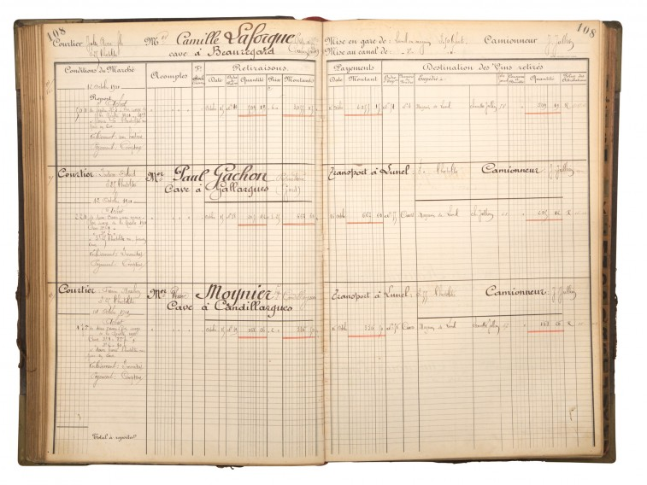
Spreadsheets
The first spreadsheet
Spreadsheet
The data is “spread” among
the sheet or sheets.

Slide 9
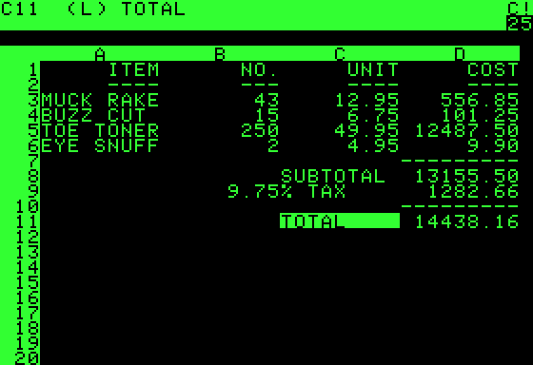
Spreadsheets
The first “modern” spreadsheet software:
VisiCalc (1979)
Initially for Apple II

Slide 10
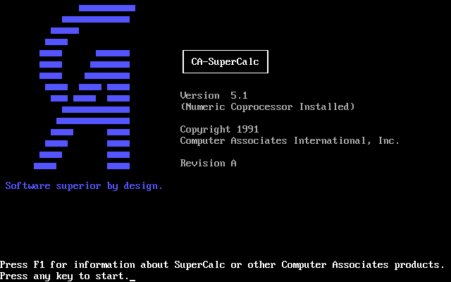
Spreadsheets
Next?
SuperCalc (1980)
For MSDOS

Slide 11
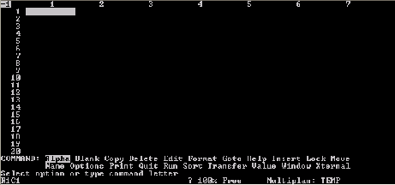
Spreadsheets
Next?
Microsoft
Multiplan (1982)
Initially for MSDOS

Slide 12
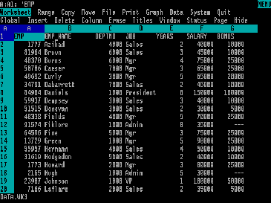
Spreadsheets
Next?
Lotus 1-2-3 (1983)
Initial version for MSDOS

Slide 13
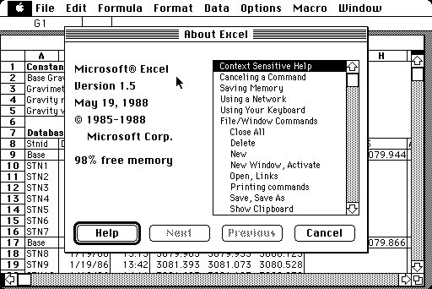
Spreadsheets
Next?
Microsoft
Excel (1985)
Initial version for Macintosh – (MSDOS in 1987)

Slide 14
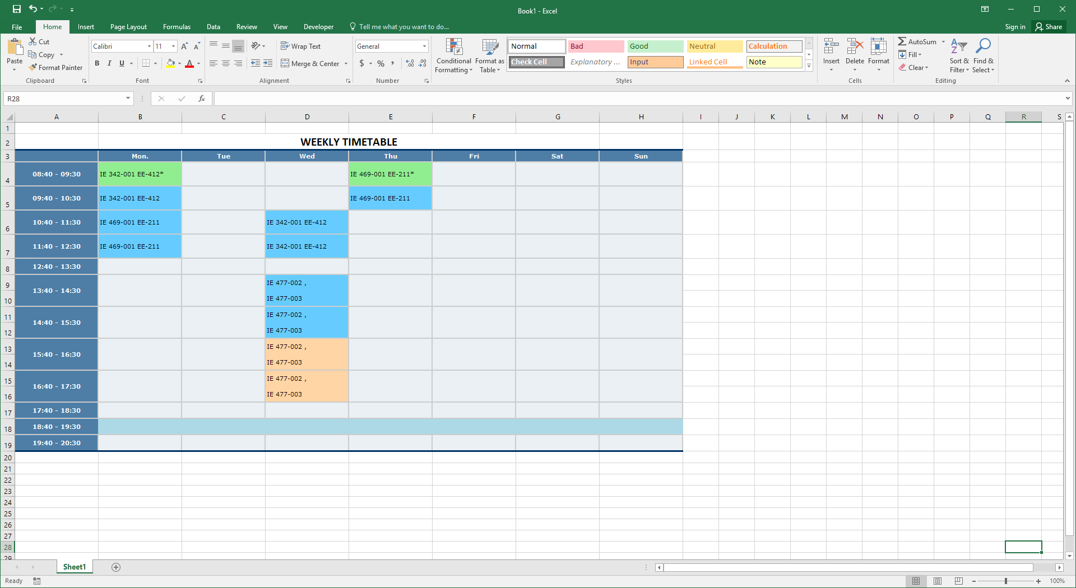


Slide 15
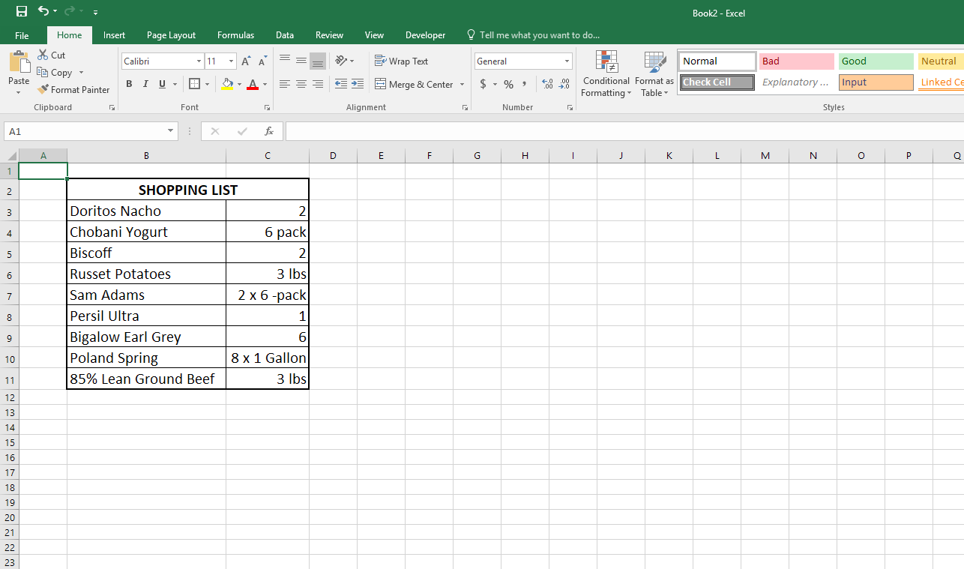
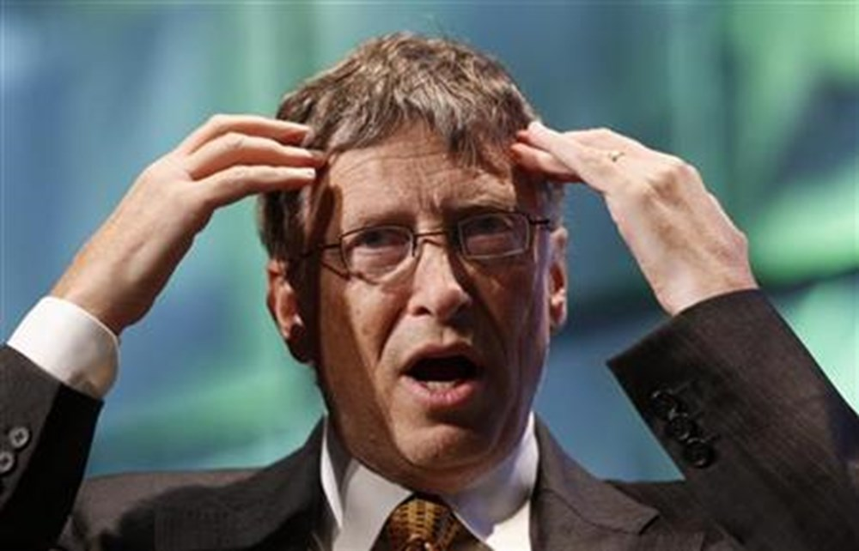


Slide 16
Spreadsheets
MS Excel is actually for tables like:
  Annual budget items
  Distance matrices
  Production plans
  Inventory levels
  i.e. Tables that include big datasets, calculations, algorithms…etc.

Slide 17
Spreadsheets
A modern spreadsheet is an interactive computer application program for organization, analysis and storage of data in tabular form.
Spreadsheets are developed as computerized simulations of paper accounting worksheets.
The program operates on data represented as cells of an array, organized in rows and columns.
Besides performing basic arithmetic and mathematical functions, modern spreadsheets provide built-in functions for common financial and statistical operations.

Slide 18
Spreadsheets
MS Excel lets you do many different applications:
  Production Planning – Use excel functions to make EOQ calculations to make production planning.
  Capacity Planning – You can use Excel Solver to solve a mathematical model to make a decision on increasing the production capacity.
  Transportation – You can code network flow algorithms (like Dijkstra, Floyd Warshall) and make routing decisions.
  Queuing Systems – You can write codes to simulate a queuing system (like a bank, airport) and make a decision on number of tellers to hire.

Slide 19
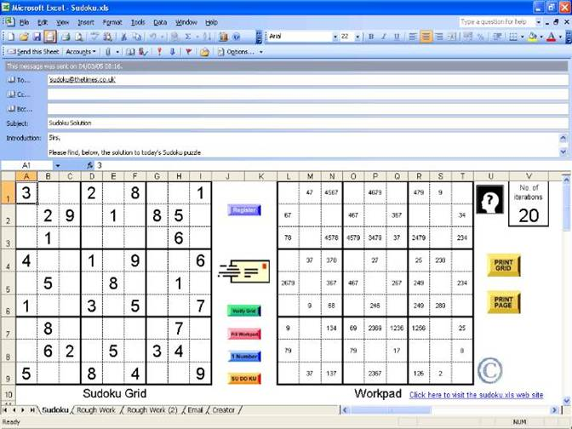
What else?

Slide 20
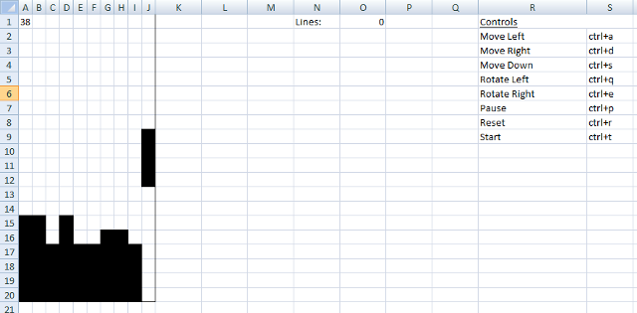
What else?

Slide 21
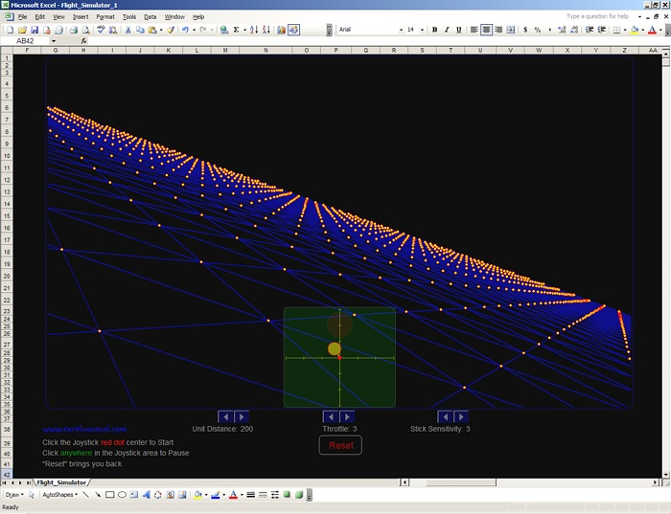
What else?

Slide 22
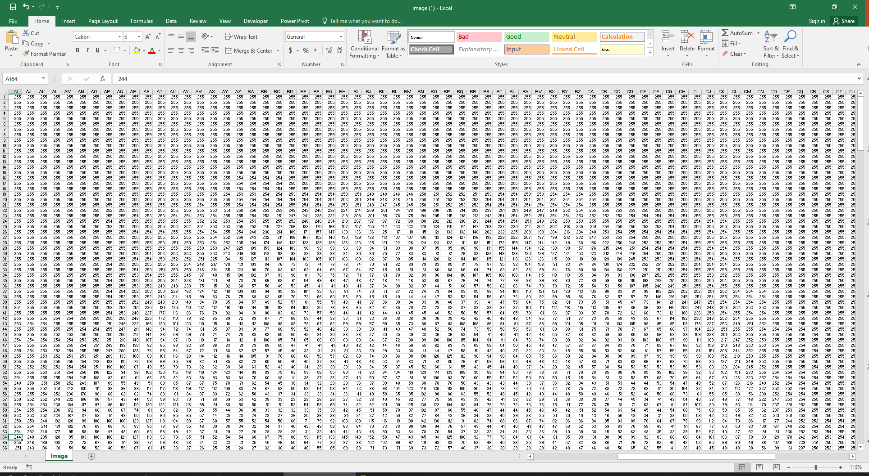

Slide 23
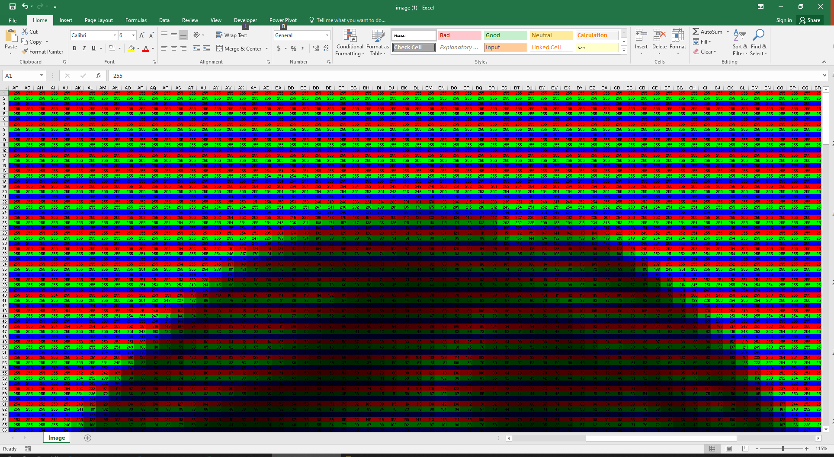

Slide 24
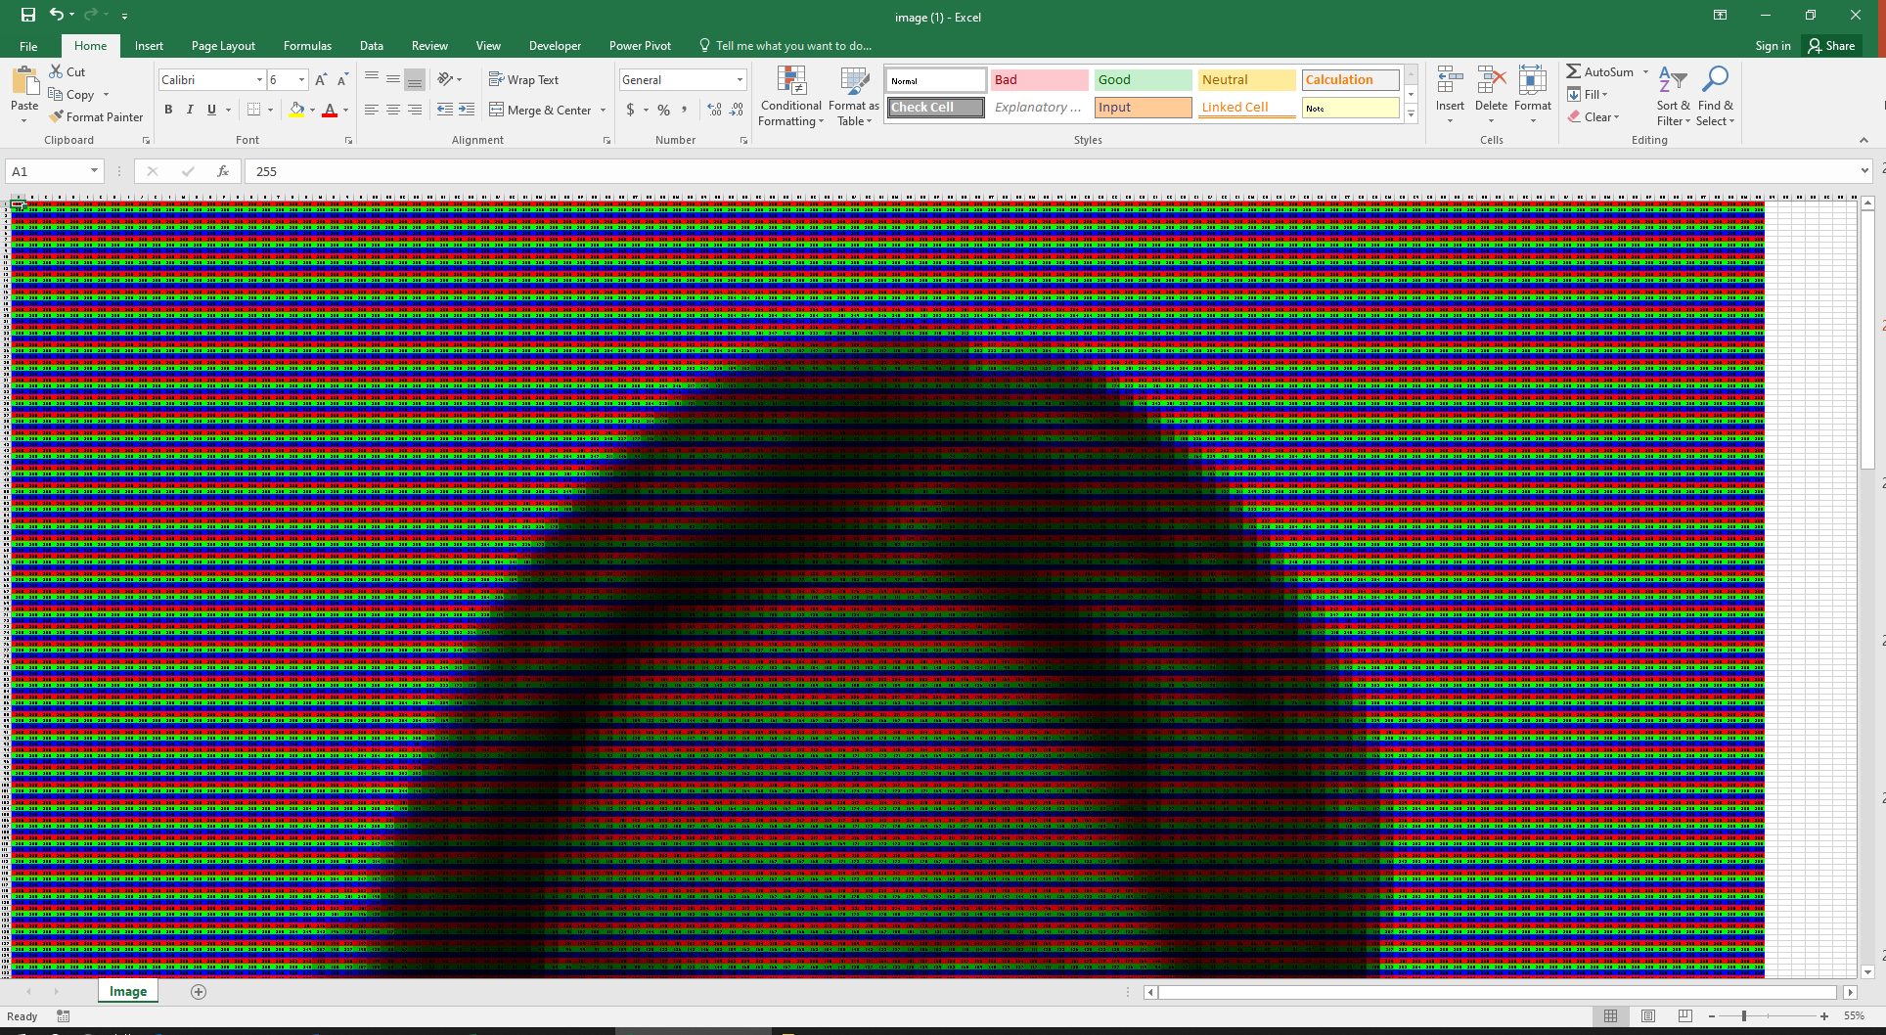

Slide 25
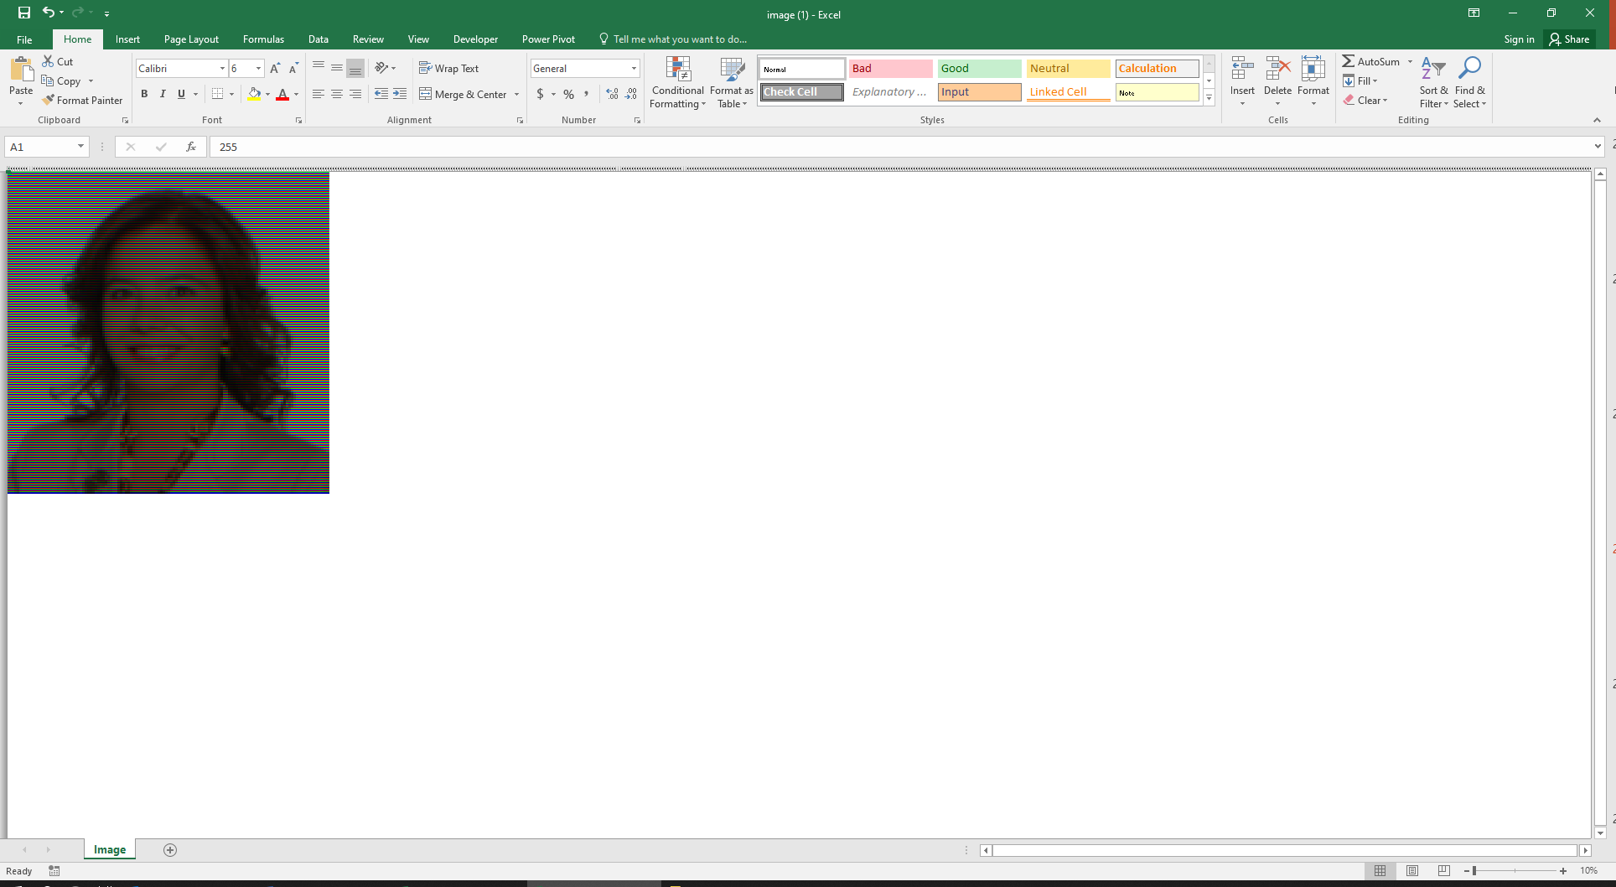

Slide 26

What else?

Slide 27
Course Objectives
You will learn how to write complex formulas using MS Excel.
  Not limited to simple sums, averages...etc
  Decision making, data analyzing (if, vlookup, pivot tables)
You will learn how to use MS Excel Solver (and OpenSolver) to handle linear and integer programming problems. (There may even be non-linear programming models)
You will learn how to handle stochastic and statistical models and do simulation in Excel.
You will learn how to code in VBA. (Not the algorithm logic!)
  You will write codes that will enable you to solve problems utilizing heuristic algorithms.
You will develop some small applications using VBA.

Slide 28
Course Objectives
This is a hands-on interactive course!
In some classes, there will be demos which you should follow on your computers.
In some classes, you will be assigned some case or lab studies.

Slide 29
Case Studies
You will be assinged some case studies as much real as I can possibly get for this course!
  There will be real datasets.
  There will be almost real situations.
You should prepare a presentable product for each case.
  Presentable: Neat, clean, easy-to-follow and result oriented.
  Just like you present to your manager.
The case studies will be on Fridays at regular class hours.
Will be done with groups of 3 students.
You will have approximately ONE day to submit your work.
  If submitted before the lecture ends → Graded on full credits
  If submitted until 17:30 the next day → Graded on 70% of the total credits.

Slide 30
Lab Studies
Lab Studies will help you learn the syntax of VBA.
  These will be similar to CS113-114-115 labs.
  You will follow instructions to first learn some syntax/functions and then will be asked to solve a related problem.
Lab studies will NOT be graded.

Slide 31
Project
This is going to be a very challenging project!
  Again a real-like project with real dataset.
  You will be ABSOLUTELY free to choose the method to solve the problems.
  Groups will compete as they will present their findings at the end of the semester.
  You will have at least a month to submit it. Start as early as you could.
  You should again prepare a presentable product.
Failing to submit the project will result in an FZ grade!

Slide 32
İlk midterme kadar basic excel bilgisi sonra bir anda şok edici şeyler oluyor. O noktadan sonra sıkı tutmak lazım. Direkt excel dersi değil kesinlikle. IE324de öğrendiklerimizi labda, IE482/IE479da öğrendiklerimizi kullandık biraz projede, belki gelecek dönemlerde de yardımcı olabilir farklı dersler. Projesi için çok zaman harcamanız gerekli.
Bu dersin en zor aşaması projesi. Grubun üç kişi olmasına özen gösterip 10 gün gerçekten üzerine uğraştıktan sonra yapılamayacak bir şey değil, son beş güne bırakmayın :)
Bu sene çok da zorlamadı projede sağ olsun keyifliydi.

Slide 33
Derste anlatılan 1, case ve projede istenilen 10. ALMAYIN. Vallahi almayın. Eski evaluationları okuyunca "Bu kadar da olmaz ya." diyorduk dönem başı. Az bile demişler. Çözülmüyor arkadaşlar anamız ağladı yok yani o proje çözülmüyor. 50+ saat harcamışımdır yine de istediğim gibi olmadı. Tamamı bitmedi zaten ona rağmen olan kısım da istediğim gibi olmadı. Bu dersi alacaksanız gidin öncesinde bir excel-vba kursuna yazılın öğrenin sonra alın.

Slide 34
Ders çok güzel. Daha önce Bilkent'te aldığım hiçbir derste bu kadar şey öğrendiğimi hatırlamıyorum. ….. Fakat dersin en kötü yanı kesinlikle projesi. 1 ay süre veriyor Emre hoca. Ben bir hata yapıp 1 ay yerine 3 haftamı ayırdım. Yetişmedi. Projeyi hiç yükleyemezseniz FZ alıyorsunuz zaten ama 1 ayda mutlaka bir şey yüklenir. Asıl sıkıntı projeyi bitirmek. 3 hafta uğraştım. Her gün belli bir vaktimi bu projeye ayırdım. Son birkaç gün sabahladım. Projedeki istasyon isimleri midemi bulandırmaya başladı. Olur da bir gün New York Penn Station ziyaret etmek durmunda kalırsam orada kusmaktan korkuyorum. Proje üstümde büyük bir travma bıraktı. Emre hoca ilk dersten projenin zor olacağını söylüyor zaten. Fakat bu kadar zor olabileceği insana pek mantıklı gelmiyor en başta. Az ders yükünüzün olduğu bir dönemde almak mantıklı, size çok şey katar. Ama yoğun bir dönemde almayın, boşuna WD harcarsınız.

Slide 35
DERS COK ZOR PROJE COK ZOR CASELER COK ZOR Projeye şakasız 40-50 saat uğraşmışımdır ama OLMUYOR. Çalışmıyor projem. Ve F yeme ihtimalım var. Bu dersi alacaklar bir kere daha düşünsün. ….. Bu derss kesinlikle 6.5 ECTS olmalıydı. Ie 202 bile artık 4 krediye cıktı, 6.5 ects oldu ve ie 202 en basit ders, ie 469 kesinlike çok daha uğraş gerektiriyor. Case'de %3 için 2 saat aralıksız çok zor bir case üzerine çalışmanız gerekiyor ve genelde yetişmiyor. Proje zaten o kadar zor ki artık benim hayatım proje oldu, gerçekten rüyalarıma giriyor, aralıksız 2 haftadır projeyi düşünüyorum her vaktimde sadece projeye bakıyorum, bugun deadline'ı bitiyor, çok güzel gerçek hayata uygun bir proje ama çok zordu. Zorluğu aslında keyif verdi çünkü beyin kullanıp çok çok düşünmek iyi oluyor fakat yazdığım kodların çalışmaması artık beni sinirlendiriyor. Dersin olumsuz yönü olarak bunu diyebilirim, beni çok yıprattı, çok zor.

Slide 36
Diğer “fazla teorik” IE derslerinin aksine işleniş şekli olarak en sevdiğim ders oldu bu ders. Haftada 1 saat lecture 2 saat lab ile problem çözerken konuları iyi öğreniyorsunuz. Projesi oldukça zor, assign edildiği an başlamanızı öneririm.
Ders bence iş hayatında en işimize yarayabilecek IE kodlu derslerden biri, projesi de abartıldığı kadar zor değil kesinlikle. Keyifli ve iş yükü çok da yüksek olmayan bir ders olduğunu düşünüyorum azıcık Excel ve kodlama bilginiz varsa önceden gelen
Zorunlu ie dersi olmalı

Slide 37
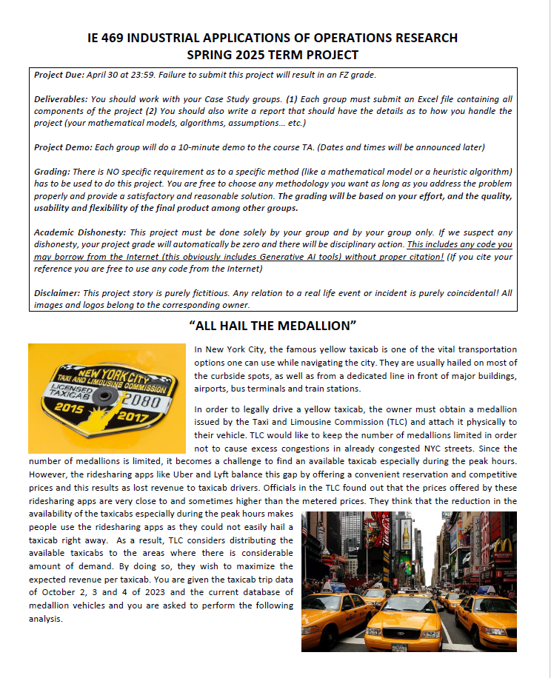
Last Year’s Project
NYC Taxi Allocation
Problem

Slide 38
This Semester’s Project
Who knows... ☺

Slide 39
Groups
Case studies and Project can be done with a group of maximum 3 students.
  Not any three students!
  No more than two students in the same group, who are also group members in IE477-IE478 courses.
  Groups of one or two students are allowed but HIGHLY DISCOURAGED!
  Once set, groups will not be changed. If your group has a problem, you may exit your group and submit assignments yourself!
Send your group info to the course TA by the end of this week!

Slide 40
Industrial Applications of Operations Research
Assessment:
  30% - Midterm Exam
  15% - 6 in-class Case Studies (Lowest dropped) (3% each)
  0% - 3 in-class Lab Studies
  25% - Group Project (Groups of max 3 students)
  30% - Final Exam

Slide 41
Software Requirements
The software Microsoft Excel for Windows is absolutely required for this course!
There are free Excel alternatives (like OpenOffice, LibreOffice) but I cannot guarantee these free alternatives will have all the functionality needed as per our coverage, especially in VBA.
If you are a Mac user, Microsoft Excel for Mac is generally fine but it does not have User Forms in VBA. So, you will need a Windows computer for at least Userforms.
If your Excel display language is not English, check Options>Language and install English as the display language. (This is required for the correct function names)

Slide 42
Software Requirements
This means, Mac users or students with no Microsoft Excel should arrange a Windows computer with Microsoft Office.
You are welcome to use the BCC Computer Labs.

Slide 43
Prerequisites
Even though IE 303 is the formal prerequisite for this course, you must be comfortable with core IE courses:
  IE 324
  IE 325
  IE 342
Statistics:
  MATH 260
Computer programming logic:
  CS 113
  CS 114
  or
  CS 115

Slide 44
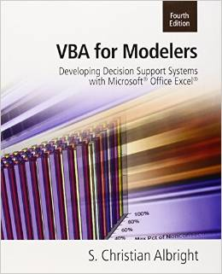
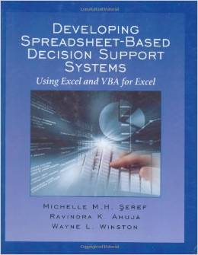
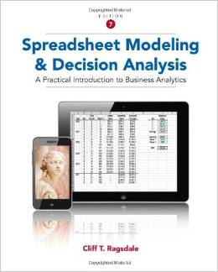
Available texts
VBA for Modelers: Developing Decision Support Systems
Author: S. Christian Albright (2007), Indiana University Kelley School of Business
Developing Spreadsheet-Based Decision Support Systems
Authors: M.H. Seref, Ravindra A. Ahuja, Wayne L. Winston (2007), University of Florida, Department of Industrial & Systems Engineering
Spreadsheet Modeling and Decision Analysis: A Practical Introduction to Business Analytics (2014)
Author : Cliff Ragsdale (College of Business at Virginia Tech)

Slide 45
Questions?

