Slide 1
Excel Solver

Slide 2
We’ll use Excel Solver to minimize or maximize functions.
Excel Solver can solve problems with constraints.

Slide 3
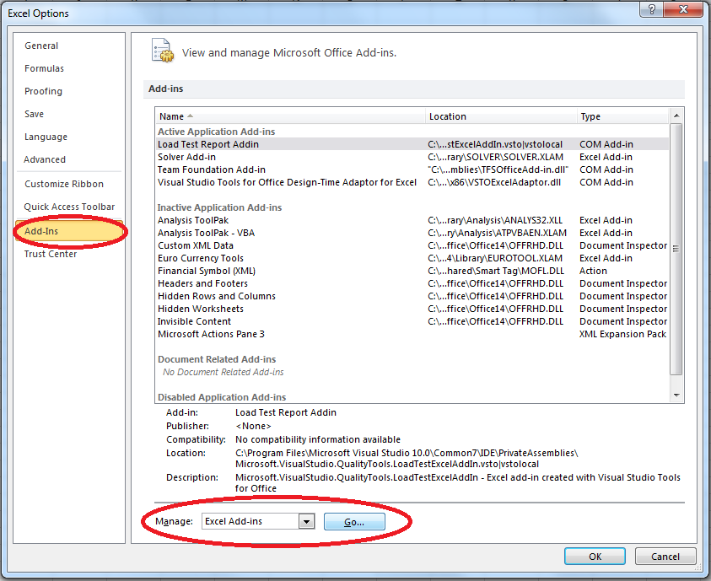
To install Excel Solver:
Go to File
Select Options
Select Add-Ins, Manage Excel Add-Ins, Go...
Choose Solver Add-in and press OK.

Slide 4
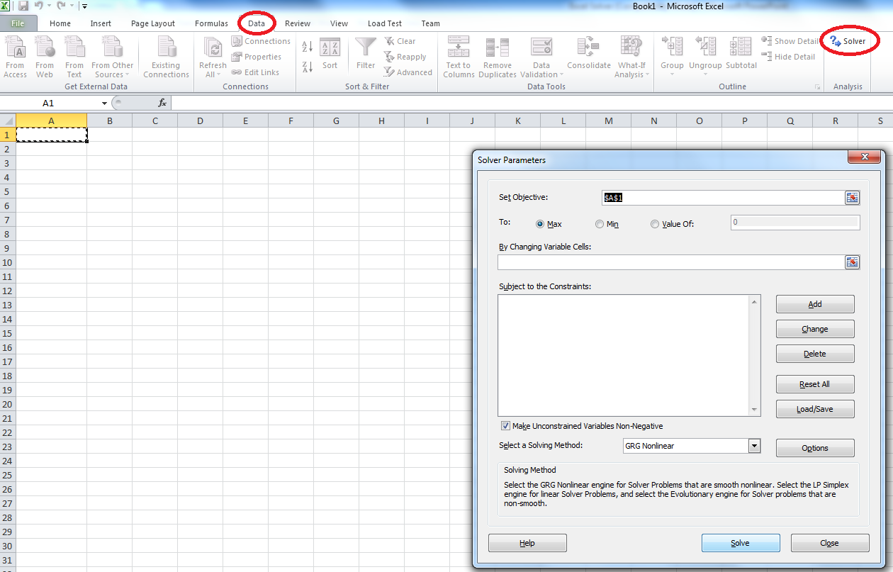
To open Solver:
Go to Data tab, Solver item is on the right side.

Slide 5
Example 1:
Let’s solve a minimization problem without constraints using Excel Solver.
For example, minimize
f(x,y) = x^2+(y-1)^2+(y-x)^2+1

Slide 6
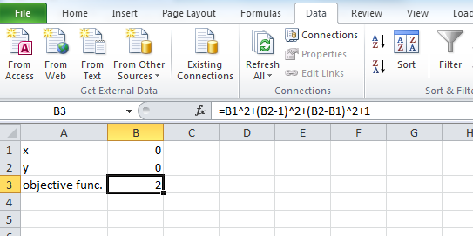
We should first write any number for x and y to an Excel sheet and formulate the objective function using these x and y cells.

Slide 7
Then open the Solver. To set objective, click the formulation of objective function.
As our problem is a minimization problem, select Min.
We want to minimize the function with variables x and y. So we will select x and y cells (the numbers we set randomly) for «By changing variable cells».
As we don’t have any constraints, we click solve.

Slide 8
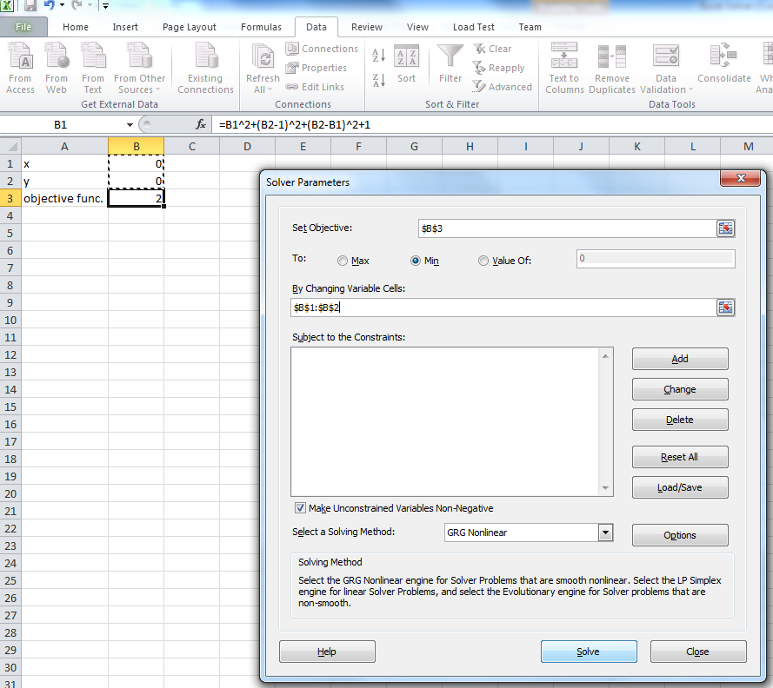

Slide 9
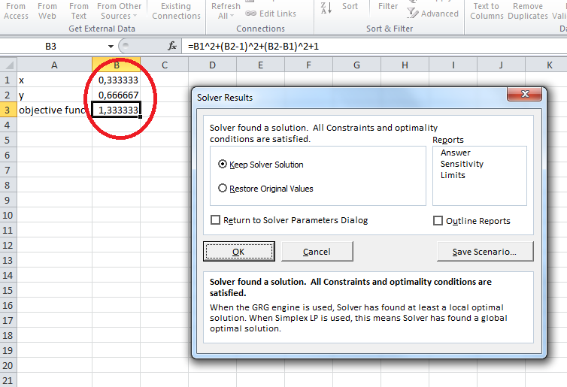
Then another dialog box opens, we select «Keep Solver Solution» and OK.
We can see the optimal solution and x,y values to obtain this solution.

Slide 10
We minimized f(x,y) without any constraint. 1.333 is the minimum value for this function with x=0.333 and y=0.667.
Example 2:
Let’s solve the same function with y>=1 constraint.

Slide 11
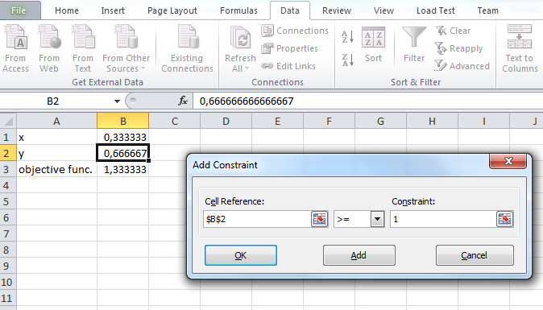
Click Add button. Select y as reference cell.
Click OK after setting y >= 1.
You can see the constraint added to Solver dialog box. Then click Solve as before.

Slide 12
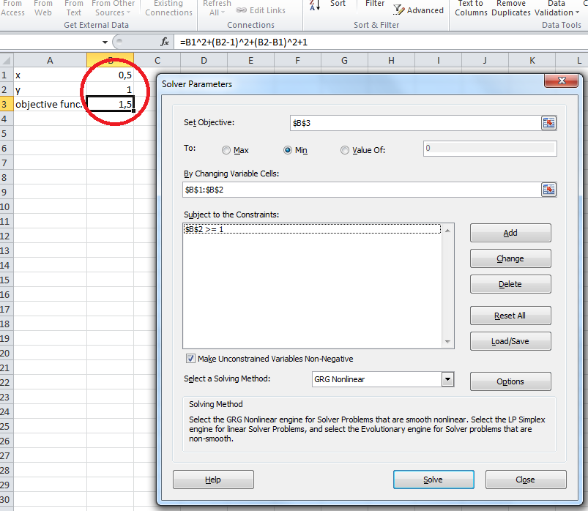
Values changed with y>=1 constraint. Minimum value of f(x,y) is now 1.5 with x=0.5 and y=1.

Slide 13
There are many formulations in Excel. You can use Help under File tab to learn more about formulas in Excel.
When you want to write a formula in a cell, you should start with an equal sign (=).

Slide 14
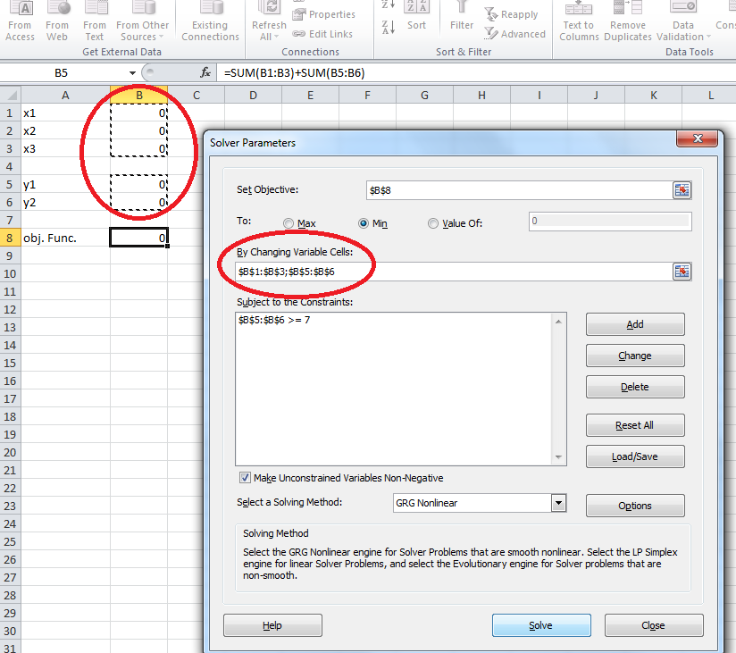
If there are more than 1 x and y values, then you should select whole x and y’s to set as variables. Objective funtion in Excel should also be formulated accordingly.

